Slide 1

Dessert Shop Location Selection
Nansen Lai

Slide 2
Background
This project is to help a retiring marketing and sales executive in Shanghai to select a location in Hong Kong for her own dessert shop.
The executive was born in Hong Kong and has a good understanding of different neighborhoods there. She has decided on 17 neighborhoods and would like some help to compare them to maximize her chance of success.

Slide 3
Approach
We used several tools to conduct analysis for the executive. We used location data from Foursquare to get the location data. We used k-means to cluster the neighborhoods to see if there are any similarities among them. We then evaluated each neighborhood based on ability to attract large crowd of people such as shopping malls, park, train station, etc. and then selected a few potential neighborhoods for her. We also looked at the number of dessert shops in each of them and selected one with the minimal number of dessert shops to minimize the competition. We also considered the rental costs to make sure we selected the most cost-effective location.

Slide 4
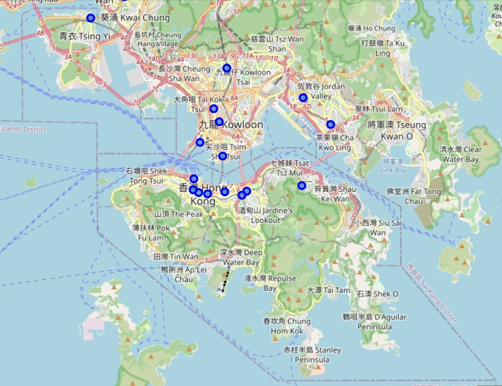
Analysis
Folium was used to draw a map of Hong Kong with marker for those 17 neighborhoods to visualize the locations of those neighborhoods in Hong Kong

Slide 5
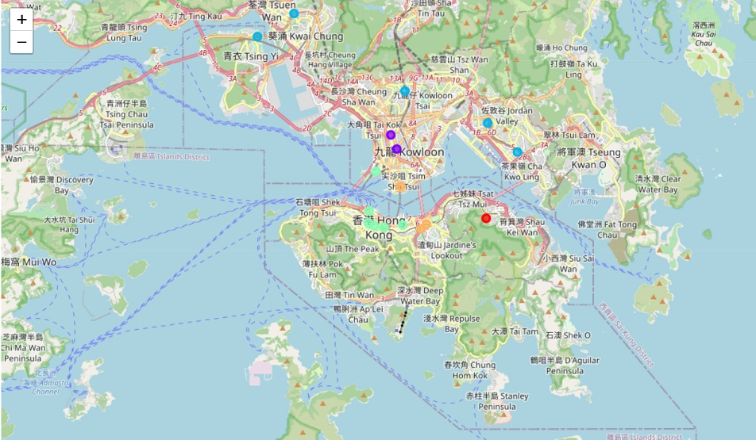
Analysis
Use Foursquare to get location data
Use k-means to cluster similar neighborhoods. Key observations:
Light blue and red are farther away from city central
All western Hong Kong Island (green) neighborhoods have similar features

Slide 6
Analysis
For further analysis, we looked at neighborhoods that would have most traffic. We used the below 20 venues from Foursquare.
Hotel Gym / Fitness Center Zoo
Park Gym Supermarket
Shopping Mall Department Store Sports Club
Metro Station Skating Rink Farmers Market
Mountain Trail Monument / Landmark
Performing Arts Venue Historic Site Train Station
Scenic Lookout Pier

Slide 7
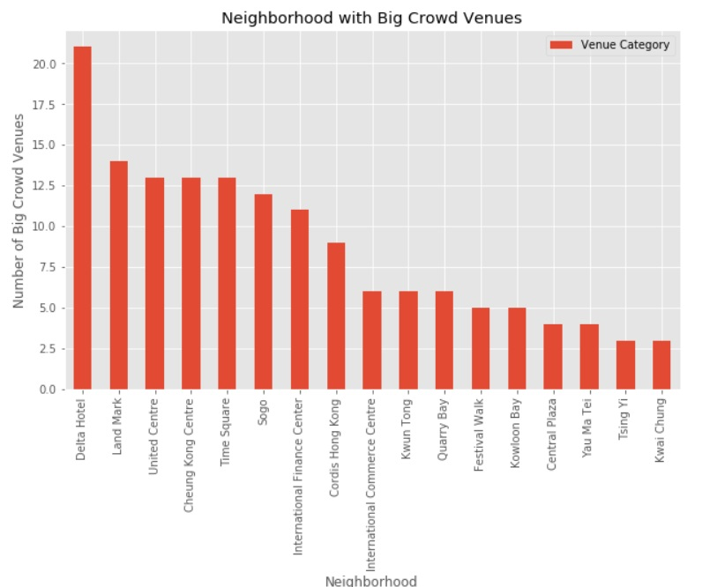
Analysis
- Using bar chart to show the number of big crowd venues in each neighborhood.
- The below neighborhoods have the largest number of big crowd venues
Delta Hotel (21)
Land Mark (14)
United Centre, Cheung Kong Centre, and Time Square (13)

Slide 8
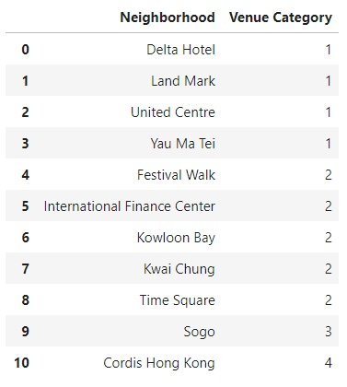
Analysis
- Now look at the number of dessert shop in each neighborhood
- The below neighborhoods have the lowest number of dessert shop
Delta Hotel (1)
Land Mark (1)
United Centre (1)
Yau Ma Tei (1)

Slide 9
Other Consideration
Rental price is usually the largest expense for a dessert shop. We also looked at the average retail rental price for the three large districts.
Hong Kong Island: HK$1,633/m²
Kowloon: HK$1,009/m²
New Territories: HK$ 1,301/m²

Slide 10
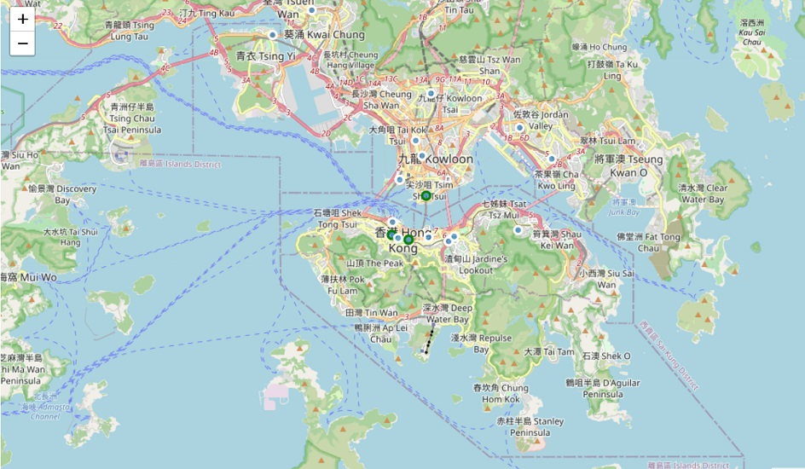
Recommendation
Based on the number of big crowd venues, the number of competitors, and rental cost, below is the neighborhood recommended.
Delta Hotel
Land Mark
United Centre

Slide 11
Summary
Neighborhood | No. of Big Crowd Venues | No. of Competitors | Rental cost
Delta Hotel | 21 | 1 | HK$1,009/m²
Land Mark | 14 | 1 | HK$1,633/m²
United Centre | 13 | 1 | HK$1,633/m²

